Slide 1
MODULE – 3 & 4
Interfaces and Exception Handling

Slide 2
INTERFACES IN JAVA

Slide 3
Contents
Introduction and Syntax
Program Examples
Adding Methods to the class
Adding Parameter to the methods
Activity

Slide 4
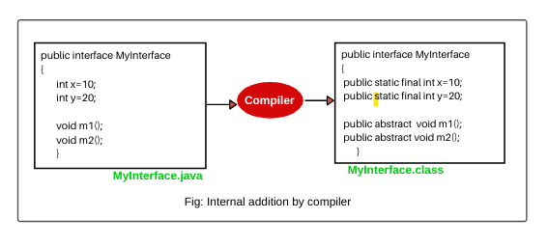
Introduction and Syntax
// interface Syntax
interface <interface_name> {
// declare constant fields
// declare methods that abstract by default.
}
// interface Example
interface Animal {
public abstract void animalSound(); // interface method (does not have a body)
public void run(); // interface method (does not have a body)
}
Examples

Slide 5
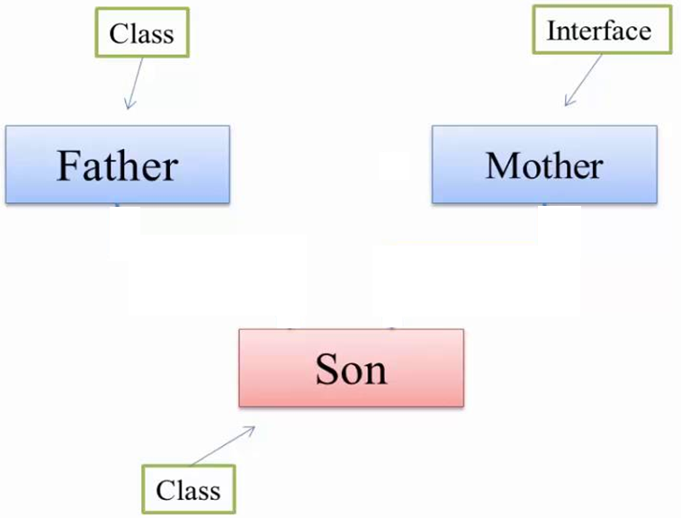
Introduction and Syntax
Examples
class A
interface A
interface A
class B
class B
interface B
class A class B extends A
{ {
//body of A //body of B
} }
interface A class B implements A
{ {
//body of A //body of B
} }
interface A interface B extends A
{ {
//body of A //body of B
} }
class father interface mother class son extends father implements mother
{ { {
//body //body //body
} } }

Slide 6
Activity
Write the class code to demonstrate the below Diagram
Interface A
Interface B
interface A interface B interface C extends A, B
{ { {
//body //body //body
} } }
Interface C
class A
interface B
interface C
class D
class A interface B interface C class D extends A implements B, C
{ { { {
//body //body //body //body
} } } }

Slide 7
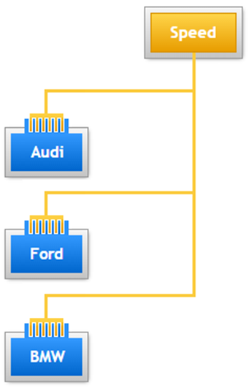
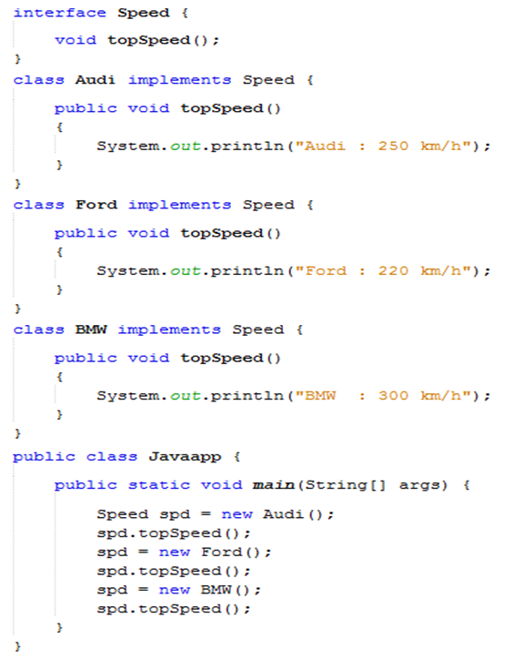
Program Examples
Dynamic Method Dispatch

Slide 8
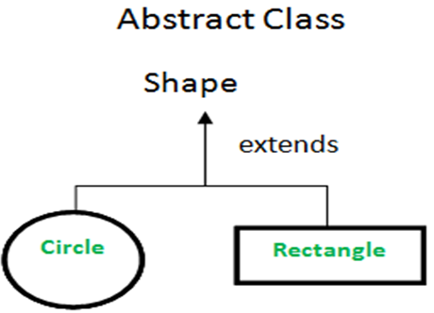
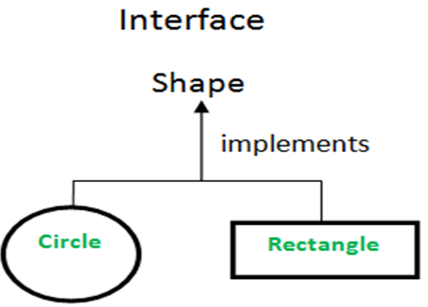
Abstract vs Interface
// Java program to illustrate the concept of abstract class
abstract class Shape {
// abstract methods which will be implemented by its subclass(es)
abstract public double area();
abstract public void draw();
}
class Rectangle extends Shape {
//body
}
class Circle extends Shape {
//body
}
class DEMO {
public static void main (String[] args) {
//body
} }
// Java program to illustrate the concept of interface
interface Shape {
// abstract methods which will be implemented by class(es)
void draw();
double area();
}
class Rectangle implements Shape {
//body
}
class Circle implements Shape {
//body
}
class DEMO {
public static void main (String[] args) {
//body
} }

Slide 9
Difference between Abstract Class and an Interface
Feature | Abstract Class | Interface
Type of methods | Abstract class can have abstract and non-abstract methods. | Interface can have only abstract methods. From Java 8, it can have default and static methods also.
Final Variables | An abstract class may contain non-final variables. | Variables declared in a Java interface are by default final.
Type of variables | Abstract class can have final, non-final, static and non-static variables. | Interface has only static and final variables.
Implementation | Abstract class can provide the implementation of interface. | Interface can’t provide the implementation of abstract class.
Inheritance vs Abstraction | abstract class can be extended using keyword “extends”. | A Java interface can be implemented using keyword “implements”.
Multiple implementation | an abstract class can extend another Java class and implement multiple Java interfaces. | An interface can extend another Java interface only.
Accessibility of Data Members | A Java abstract class can have class members like private, protected, etc. | Members of a Java interface are public by default.

Slide 10
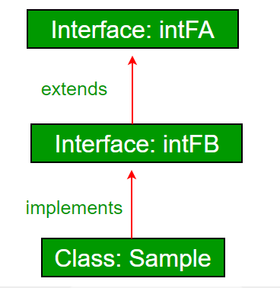
Program Examples
// Java program to demonstrate inheritance in interfaces.
interface intfA {
void Name();
}
interface intfB extends intfA {
void Institute();
}
// class implements both interfaces and provides implementation to the method.
class InterfaceExtends implements intfB {
@Override
public void Name() {
//Body
}
@Override
public void Institute() {
}
public static void main (String[] args) {
InterfaceExtends ob1 = new InterfaceExtends ();
// calling the method implemented within the class.
ob1.Name();
ob1.Institute();
} }
Inheritance in Interfaces

Slide 11
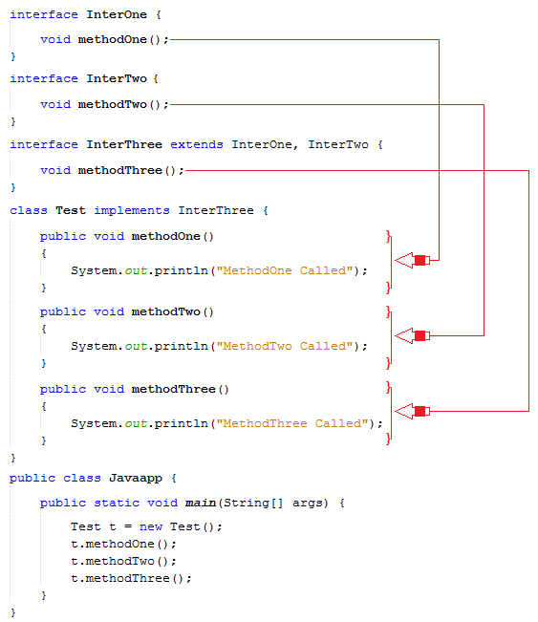
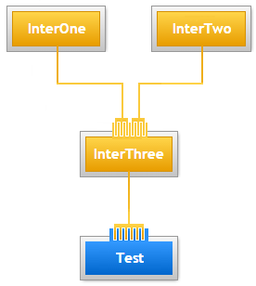
Program Examples
Example for Multiple Inheritance through Interfaces

Slide 12
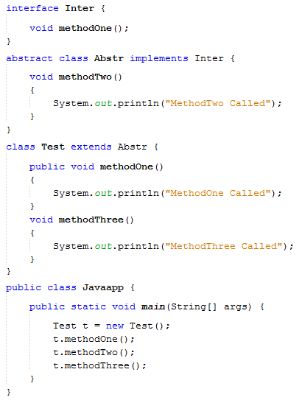
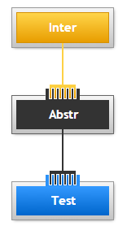
Program Examples
Abstract Class implements an Interface

Slide 13
EXCEPTIONS

Slide 14
Contents
Exceptions and its Types
Exception Clauses (try, catch, throw, throws and finally )
Java’s Built-in Exceptions
Activity

Slide 15
Exceptions
Introduction
Compilation
Execution
Error or Exception
classes.zip:
classes needed at run- time by Java Interpreter
Action to be taken
Java Code
Exception Type determined
Object of Exception Class created
Related message displayed
Exception Classes
Java Compiler
Bytecode
javac
Java Interpreter
java
If No Errors
Program Execution

Slide 16
Throwable Exceptions
Exceptions
Throwable
Exception
Error
Linkage Error
Run-time Exception
Class Not Found
Stack overflow
Array Index Out Of Bounds

Slide 17
Throwable Exceptions
Exceptions
an Error is used by the Java run-time system (JVM) to indicate errors that are associated with the run-time environment (JRE). StackOverflowError is an example of such an error.
Whereas Exception is used for exceptional conditions that user programs should catch. NullPointerException is an example of such an exception.
Sl. No | Errors | Exceptions
1 | Impossible to recover from an error | Possible to recover from exceptions
2 | Errors are of type ‘unchecked’ | Exceptions can be either ‘checked’ or ‘unchecked’
3 | Occur at runtime | Can occur at compile time or run time
4 | Caused by the application running environment | Caused by the application itself

Slide 18
Exceptions
Types of Exceptions
Exceptions
Built-in Exceptions
User-Defined Exceptions
Examples
Built-in Exceptions | Description
ArithmeticException | It is thrown when an exceptional condition has occurred in an arithmetic operation.
ArrayIndexOutOfBoundsException | It is thrown to indicate that an array has been accessed with an illegal index. The index is either negative or greater than or equal to the size of the array.
ClassNotFoundException | This exception is raised when we try to access a class whose definition is not found.
FileNotFoundException | An exception that is raised when a file is not accessible or does not open.
IOException | It is thrown when an input-output operation is failed or interrupted.

Slide 19
Exceptions
Methods available in Exception Class
Sr. No. | Method & Description
1 | public String getMessage() Returns a detailed message about the exception that has occurred. This message is initialized in the Throwable constructor.
2 | public String toString() Returns the name of the class concatenated with the result of getMessage().
3 | public void printStackTrace() Prints the result of toString() along with the stack trace to System.err, the error output stream.
4 | public Throwable fillInStackTrace() Fills the stack trace of this Throwable object with the current stack trace, adding to any previous information in the stack trace.

Slide 20
Exceptions
Example
This will generate an error, because myNumbers[10] does not exist.
class Exception_Ex1{
public static void main(String[ ] args) {
int[] myNumbers = {1, 2, 3};
System.out.println(myNumbers[10]); // error!
}
}
OUTPUT
Javac Exception_Ex1.java
Exception in thread "main" java.lang.ArrayIndexOutOfBoundsException: 10 at Main.main(Main.java:4)

Slide 21
Exceptions
Java exception-handling
Five Keywords used are:
try
catch
throw
throws
finally
In a program, if there is a chance of rising an exception then compiler always warn us about it and compulsorily we should handle that checked exception, Otherwise we will get compile time error saying unreported exception XXX must be caught or declared to be thrown. To prevent this compile time error we can handle the exception in two ways:
By using try catch
By using throws keyword

Slide 22
Exceptions
try-catch
The try block contains a set of statements where an exception can occur. It is always followed by a catch block, which handles the exception that occurs in the associated try block.
A try block must be followed by catch blocks or finally block or both.
A catch block is where you handle the exceptions. This block must follow the try block and a single try block can have several catch blocks associated with it.
We can catch different exceptions in different catch blocks.
When an exception occurs in a try block, the corresponding catch
block that handles that particular exception executes.
To perform various tasks at the occurrence of various exceptions,
we can use the multi-catch block.
Syntax:
try{
//code that may throw exception
}
catch(Exception_class_Name ref){
//Exception handled body
}

Slide 23
Exceptions
try-catch : Control Flow
If an error occurs, we can use try...catch to catch the error and execute some code to handle it:
Code before try
class try_catch{
public static void main(String[ ] args) {
try {
int[] myNumbers = {1, 2, 3};
System.out.println(myNumbers[10]);
}
catch (Exception e) {
System.out.println("Something went wrong.");
}
} }
exception occurs
try block
catch block
no exception occur
exception Handled
Exception occurs and handled in catch
code after try
OUTPUT
Java try_catch
Something went wrong.

Slide 24
Exceptions
Finally : Control Flow
Program Code
The possible combinations of try-catch-finally which may happen whenever an exception is raised and how the control flow occurs in each of the given cases.
Control flow in try-catch clause OR try-catch-finally clause
Case 1: Exception occurs in try block and handled in catch block
Case 2: Exception occurs in try-block is not handled in catch block
Case 3: Exception doesn’t occur in try-block
try-finally clause
Case 1: Exception occurs in try block
Case 2: Exception doesn’t occur in try-block
No
Exception Occurred ?
Yes
Exception Handled
?
No
Yes
Finally block will be executed

Slide 25
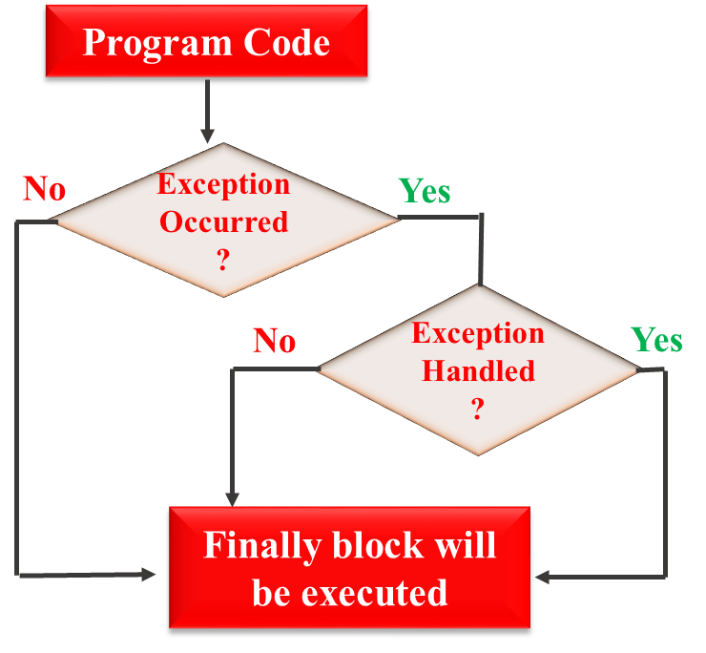
Exceptions
Finally : Example
class case1 {
public static void main(String[] args) {
try {
int[] myNumbers = {1, 2, 3};
System.out.println(myNumbers[10]);
}
catch (Exception e) {
System.out.println("Something went wrong.");
} finally {
System.out.println("The 'try catch' is finished.“);
} } }
Case 1: Exception occurs in try block and handled in catch block
Exception occurs and handled in catch
OUTPUT
Java case1
Something went wrong. The 'try catch' is finished.

Slide 26
Exceptions
Finally : Example
class case2{
public static void main (String[] args) {
// array of size 4.
int[] arr = new int[4];
try {
int i = arr[4];
// this statement will never execute as exception is raised by
above statement
System.out.println("Inside try block");
}
// not a appropriate handler
catch(NullPointerException ex) {
System.out.println("Exception has been caught");
}
finally {
System.out.println(“Finally block is executed.“);
} }
Case 2: Exception occurs in try block and not handled in catch block

Slide 27
Exceptions
Finally : Example
class case3{
public static void main (String[] args) {
try {
String str = "123";
int num = Integer.parseInt(str);
// this statement will execute
// as no any exception is raised by above statement
System.out.println("try block fully executed");
}
catch(NumberFormatException ex) {
System.out.println("catch block executed...");
}
finally {
System.out.println("finally block executed");
}
System.out.println("Outside try-catch-finally clause");
} }
Case 3: Exception doesn’t occur in try-block

Slide 28
Exceptions
throw
class throw_Ex1{
static void checkAge(int age) {
if (age < 18) {
throw new ArithmeticException("Access denied - You must be at least 18 years old.");
}
else {
System.out.println("Access granted - You are old enough!");
}
}
public static void main(String[] args) {
checkAge(15);
// Set age to 15 (which is below 18...)
} }
The keyword “throw” is used to hand over our created exception instance to the JVM manually.
If “throw” is not used to throw an exception instance and the exception occurs, then the runtime system internally throws the exception instance to JVM and the program terminates abnormally.
The general form of the throw keyword is:
throw Throwable_instance;
Example: throw new ArithmeticException("/ by zero");
Example

Slide 29
Exceptions
throws
throws is a keyword in Java which is used in the signature of method to indicate that this method might throw one of the listed type exceptions.
The caller to these methods has to handle the exception using a try-catch block.
The general form of the throws keyword is:
// Java program to illustrate throws
class throws_Ex1 {
public static void main(String[] args) throws Exception
{
throw new Exception();
}
}
Solution
// Java program to illustrate error in case
// of unhandled exception
class throws_Ex1 {
public static void main(String[] args) {
throw new Exception();
}
}
type method_name(parameters) throws exception_list
exception_list is a comma separated list of all the
exceptions which a method might throw.
Problem
Example

Slide 30
Exceptions
throw vs throws
Exception Instance
Responsibility of Handling Exception
throw
JVM
throws
Calling method
Sl. No. | throw | throws
1 | Used to explicitly throw an exception | Used to declare an exception
2 | Checked exceptions cannot be propagated using throw only | Checked exceptions can be propagated
3 | Followed by an instance | Followed by a class
4 | Used within a method | Used with a method signature
5 | Cannot throw multiple exceptions | Can declare multiple exceptions

Slide 31
Module Completed

